Slide 1
Text file handling

Slide 2
Today’s agenda
Last time
Today
Switch Statements
Examine what happens when our code “goes wrong” through errors and exceptions.
Data persistence - Introduction to text file handling.
IO classes
Writing/Amending files
Reading from files
IO exceptions
try with resources

Slide 3
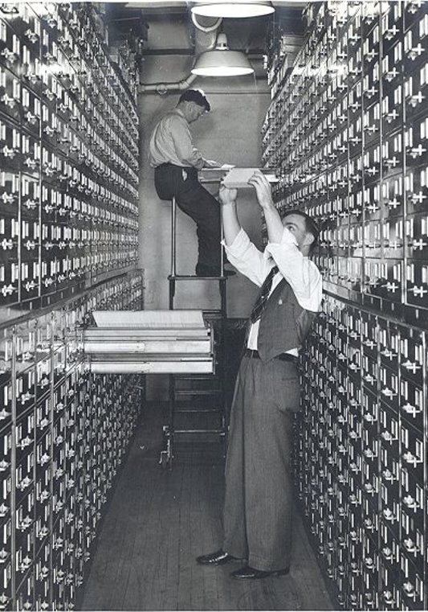
Data persistence
Introduction to text file handling to store data

Slide 4
Input
Keyboard
Mouse
Processing
Software
Output
Screen
Network
Printer
Hardware
Files
Files

Slide 5
Data files – Persistent data
Store data from a program, writing it to file.
Provide data to a program, reading it from a file.
File formats:
text (characters)
binary (bits/ bytes)
Java file streams
sequential streams of characters
streams of bytes

Slide 6
Files and streams (java.io package)
File – stream of bytes
Byte streams derived from
InputStream & OutputStream
Character streams
FileReader & FileWriter
Scanner( java.util package) , PrintWriter
Most methods of I/O classes throw IOException
File class - provides details of file, but no I/O functionality

Slide 7
Standard streams (java.lang package)
System.in an InputStream object [doc link]
System.out a PrintStream object [doc link]
System.err a PrintStream object
We use these in constructors for other I/O classes
e.g. class Scanner
Other I/O classes
BufferedReader / BufferedWriter class for speed

Slide 8
Java File class
import java.io.*;
This class has data about a file and its path
Constructor takes a String for the external file pathname: File confidential = new File("secrets.txt");
The File class has methods to
check if file exists,
create file
delete file
....and more
Does not have methods to read from or write to file

Slide 9
Examples of File Class methods
exists(): boolean
Returns true if the file denoted by this pathname actually exists, false otherwise, for example: boolean fileExists = confidential.exists();
createNewFile(): boolean
Creates a new file with this abstract pathname if the file does not already exist.
Returns true if a file is created, false otherwise, for example: boolean b = confidential.createNewFile();

Slide 10
Writing to Text files
General process
create a file to write to
write data to file
close file
We’ll use a PrintWriter [docs] class for writing to files
java.io package
Give the files external filenames ending in .txt

Slide 11
PrintWriter for writing to files
One of the PrintWriter constructors takes an object of the File class as an argument
If the file already exists it will be overwritten.
We can check to see if the file already exists first, using the File method exists(), if we don’t want to overwrite it.
PrintWriter throws a checked exception: FileNotFoundException
“If the given file object does not denote an existing, writable regular file and a new regular file of that name cannot be created, or if some other error occurs while opening or creating the file”
https://docs.oracle.com/en/java/javase/11/docs/api/java.base/java/io/PrintWriter.html
Notes:
https://docs.oracle.com/en/java/javase/11/docs/api/java.base/java/io/PrintWriter.html

Slide 12
PrintWriter for output
File confidential = new File("secrets.txt");
// declare the PrintWriter object outside the try block
PrintWriter output = null;
// check that the file doesn't already exist
if(!confidential.exists())
{
try
{
output = new PrintWriter(confidential);
}
catch (FileNotFoundException e)
{
System.out.println("Error : program closing");
System.exit(0); // this terminates the program
}
}

Slide 13
PrintWriter methods
The two main methods of the PrintWriter class are print() and println()‏ as well printf() to format the output.
If the file already exists it will be overwritten.
The append() method can be used to add text to a file in a non destructive fashion.
When you are finished, terminate the writing session with the close() method.
Failure to do so can lead to data not being written to the file.

Slide 14
Example
TestFileWrite.java

Slide 15
File Input / Output (cont’d)
// ..create PrintWriter object
int num = 6;
String str = "hello";
output.println(num); // write “6” to file
output.println(str); // write “hello” to file
output.append(num); // append “6” to file
output.close();

Slide 16
File Input / Output - appending to a File
Another way to append data to a File is to use the FileWriter constructor which takes an extra parameter
FileWriter(filename, boolean var)
if var == true data is appended
if var == false data is overwritten
and wraps the PrintWriter constructor around it.
PrintWriter output = new PrintWriter(new FileWriter(filename, true));
FileWriter is a low-level class, whilst PrintWriter is a high-level class that wraps around the low-level one.

Slide 17
Example
TestPrintWriterAppend.java

Slide 18
Reading data from text files
General process:
open the file for reading
perform read methods
close file
The file must already exist (we can check this).
Numerous ways to read from character-based file in Java ( e.g. FileReader, BufferedReader classes in java.io package) – we will use the Scanner class

Slide 19
Opening a file for reading
To open the file
File object used - constructor uses name of text file
Create a Scanner from the File
FileNotFoundException is thrown
The file can be created beforehand
by using a text editor
by writing the file by a Java program
Using the Linux CLI: touch myfile.txt
etc
Scanner infile;
infile = new Scanner(new File("myfile.txt"));

Slide 20
File Input / Output
Scanner s = null;
try
{
File confidential = new File(“secrets.txt”);
s = new Scanner(confidential);
}
catch (FileNotFoundException e)‏
{
System.out.println(“Error – file not found!”);
}

Slide 21
Scanner for reading text files
When the file has been opened successfully, you can read using the Scanner methods
e.g.
String name = infile.nextLine();
int num = infile.nextInt();
However, you may need to know what is in the file to use the correct Scanner method,(nextInt(), nextDouble(), etc…) or use next() to get the next token as a string !
When finished reading, close the file: infile.close();

Slide 22
Reading data until end of file
Files may contain unknown number of data items
Use a while-loop controlled by more tokens for the Scanner to read
while (input.hasNext())
{
//do something with the next token e.g
// display on screen
String s = input.next();
System.out.println(s);
}

Slide 23
Example
TestFileReading.java

Slide 24
Summary
The File class provides an abstract, system-independent, way of referring to files.
The PrintWriter class can be used to write data to a text file.
The Scanner class can be used to read data from a text file.
Both File and PrintWriter constructors throw exceptions that must be handled.
try with resources will ensure that objects are automatically closed when they’re no longer required if they implement the close method defined by the AutoClosable interface

Slide 25
try with resources

Slide 26
try with resources
Java 7 introduced a variation to exception handling known as try with resources
The purpose was ensure that objects that needed to be closed were done automatically
As part of the try statement, you declare the object(s) that need to be automatically closed, for example Scanner:
try(final Scanner fileScanner = new Scanner(new FileReader("./data/employees.csv"))) { // do something with the fileScanner object, e.g.
while(fileScanner.hasNextLine()) {
// etc ...
} } catch (FileNotFoundException ex) {
Logger.getLogger(Main.class.getName()).log(Level.SEVERE, null, ex);
}
fileScanner.close() is automatically called when the try/catch is completed – meaning you don’t have to

Slide 27
AutoClosable
An interface that defines a method that objects that need to be automatically closed need to implement
More about interfaces later in the module
The IO classes that we’ve looked at today all do this, as such they will work with try with resources, for example BufferedWriter:
try(BufferedWriter bw = new BufferedWriter(new FileWriter("data.txt"))) {
bw.write("hello");
} catch(IOException ex) {
System.out.println("Unable to open file for writing...");
}

